Slide 1
The Valuation Process
A. Discounted Cash Flow Models
  1. Present value of dividends (DDM)
  2. Present value of free cash flow to equity (FCFE)
  3. Present value of free cash flow (FCFF)
B. Relative valuation techniques
  1. Price earnings ratio (P/E)
  2. Price cash flow ratios (P/CF)
  3. Price book value ratios (P/BV)
  4. Price sales ratio (P/S)

Slide 2
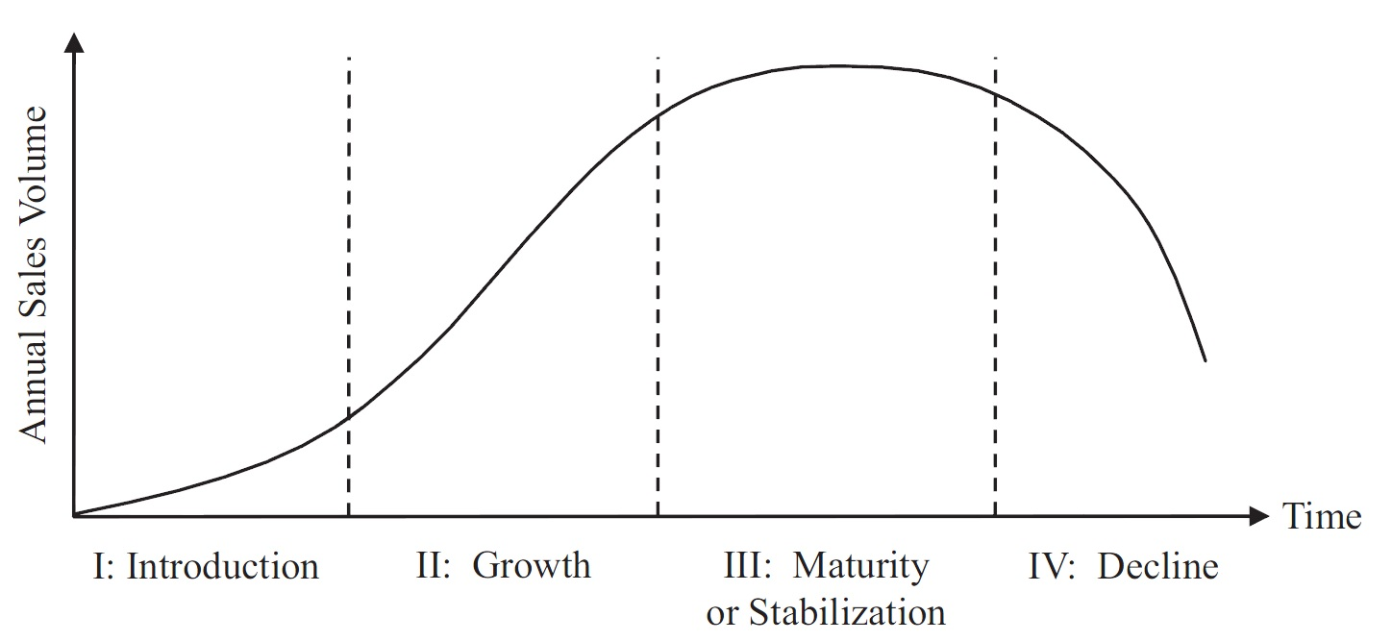
Discounted Cash Flow Models
1. Constant Growth Model
2. The Two-Period Growth Model
3. The Three-Period Model

Slide 3
Required Factors for the Valuation
The discounted cash flow approaches are dependent on some factors, namely:
  The rate of growth and the duration of growth of the cash flows
  The estimate of the discount rate

Slide 4
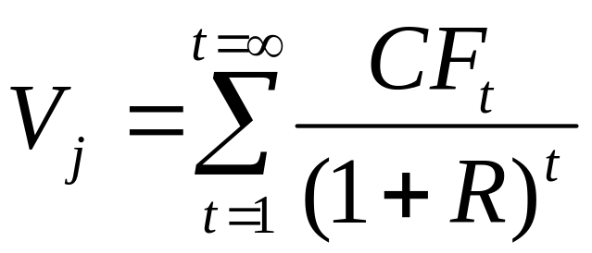
Discounted Cash-Flow Valuation Techniques
Where:
V_{j} = value of stock j
T = infinite life of the asset
CF_{t} = cash flow in period t
R = the discount rate that is equal to the investor’s required rate of return for asset j, which is determined by the uncertainty (risk) of the stock’s cash flows

Slide 5
Valuation Based on Comparable Firms
Another application of the valuation principle is the method of comparables
  Estimate the value of the firm based on the value of other, comparable firms or investments that we expect will generate very similar cash flows in the future

Slide 6
Valuation Based on Comparable Firms
Consider the case of a new firm that is identical to an existing publicly traded firm
  The Valuation Principle implies that two securities with identical cash flows must have the same price
  If these firms will generate identical cash flows, we can use the market value of the existing company to determine the value of the new firm
  We can adjust for scale differences using valuation multiples

Slide 7
Valuation Based on Comparable Firms
Consider the case of a new firm that is identical to an existing publicly traded firm
  The Valuation Principle implies that two securities with identical cash flows must have the same price
  If these firms will generate identical cash flows, we can use the market value of the existing company to determine the value of the new firm
  We can adjust for scale differences using valuation multiples

Slide 8
Valuation Based on Comparable Firms
Valuation Multiples
  A ratio of a firm’s value to some measure of the firm’s scale or cash flow
    Price-Earnings ratio
    Enterprise Value Multiples
    Other multiples
      Multiples of sales
      Price-to-book value of equity
      Industry- specific ratios

Slide 9
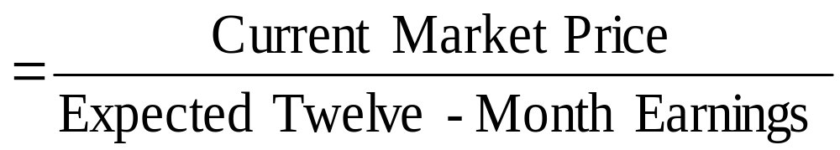
Earnings Multiplier Model
This values the stock based on expected annual earnings
The price earnings (P/E) ratio, or
Earnings Multiplier

Slide 10
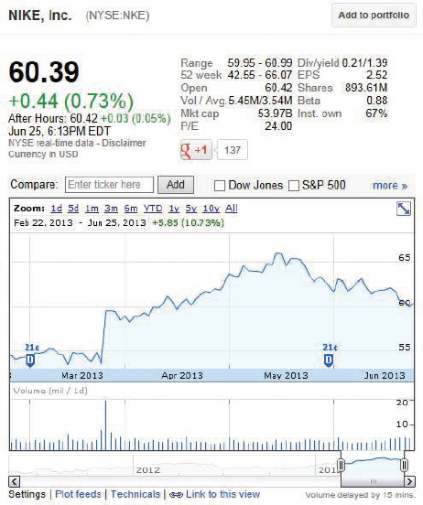
Valuation Based on Comparable Firms
Price-Earnings Ratio
  Most common valuation multiple
    Usually included in basic statistics computed for a stock
  Share price divided by earnings per share

Slide 11
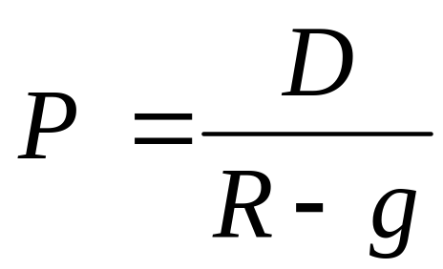
Earnings Multiplier Model
The infinite-period dividend discount model indicates the variables that should determine the value of the P/E ratio

Slide 12
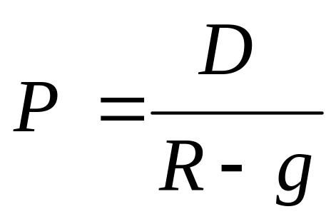
Earnings Multiplier Model
The infinite-period dividend discount model indicates the variables that should determine the value of the P/E ratio
Dividing both sides by expected earnings during the next 12 months (E)

Slide 13
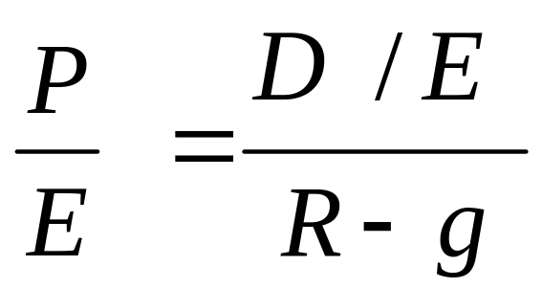
Earnings Multiplier Model
The infinite-period dividend discount model indicates the variables that should determine the value of the P/E ratio
Dividing both sides by expected earnings during the next 12 months (E)

Slide 14
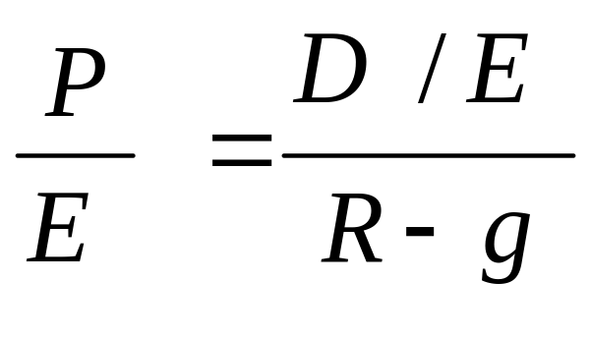
Earnings Multiplier Model
Thus, the P/E ratio is determined by
  1. Expected dividend payout ratio
  2. Required rate of return on the stock (R)
  3. Expected growth rate of dividends (g)

Slide 15
Example Valuation Using the Price-Earnings Ratio
Problem:
Suppose furniture manufacturer Herman Miller, Inc., has earnings per share of $1.38.
If the average P/E of comparable furniture stocks is 21.3, estimate a value for a share of Herman Miller stock using the P/E as a valuation multiple.
What are the assumptions underlying this estimate?

Slide 16
Example Valuation Using the Price-Earnings Ratio
Solution:
Plan:
We estimate a share price for Herman Miller by multiplying its EPS by the P/E of comparable firms:
P₀ = $1.38×21.3 = $29.39.
This estimate assumes that Herman Miller will have similar future risk, payout rates, and growth rates to comparable firms in the industry.

Slide 17
Example Valuation Using the Price-Earnings Ratio
Evaluate:
Although valuation multiples are simple to use, they rely on some very strong assumptions about the similarity of the comparable firms to the firm you are valuing.
It is important to consider whether these assumptions are likely to be reasonable—and thus to hold—in each case.

Slide 18
Earnings Multiplier Model
As an example, assume:
  Dividend payout = 50%
  Required return = 12%
  Expected growth = 8%
  D/E = .50; R = .12; g=.08

Slide 19
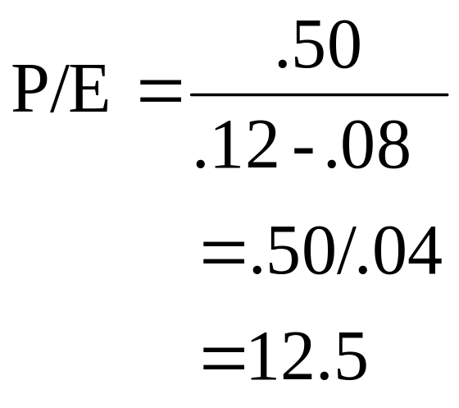
Earnings Multiplier Model
As an example, assume:
  Dividend payout = 50%
  Required return = 12%
  Expected growth = 8%
  D/E = .50; R = .12; g=.08

Slide 20
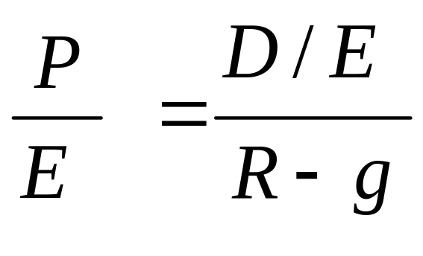
Earnings Multiplier Model
A small change in either or both R or g will have a large impact on the multiplier

Slide 21

Earnings Multiplier Model
A small change in either or both R or g will have a large impact on the multiplier
D/E = .50; R=.13; g=.08
P/E = .50/(.13-/.08) = .50/.05 = 10

Slide 22

Earnings Multiplier Model
A small change in either or both R or g will have a large impact on the multiplier
D/E = .50; R=.13; g=.08 P/E = 10
D/E = .50; R=.12; g=.09 P/E = 16.7

Slide 23
Earnings Multiplier Model
A small change in either or both R or g will have a large impact on the multiplier
D/E = .50; R=.13; g=.08 P/E = 10
D/E = .50; R=.12; g=.09 P/E = 16.7
D/E = .50; R=.11; g=.09

Slide 24
Earnings Multiplier Model
A small change in either or both R or g will have a large impact on the multiplier
D/E = .50; R=.13; g=.08 P/E = 10
D/E = .50; R=.12; g=.09 P/E = 16.7
D/E = .50; R=.11; g=.09 P/E = 25

Slide 25
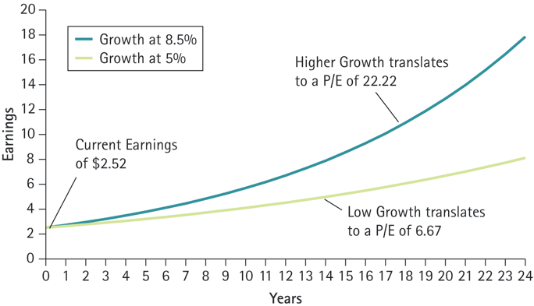
Figure Relating the P/E Ratio to Expected Future Growth

Slide 26
Valuation Based on Comparable Firms
We can compute a firm’s P/E ratio using:
  Trailing earnings
  Forward earnings
The resulting ratio is either:
  Trailing P/E
  Forward P/E
    For valuation purposes, the forward P/E is generally preferred, as we are most concerned about future earnings

Slide 27
Example Growth Prospects and the Price-Earnings Ratio
Problem:
Amazon.com and Walmart’s are retailers. On November 4, 2019, Amazon had a price of $1806.72 and forward earnings per share of $22.57. Walmart had a price of $117.30 and forward earnings per share of $4.42.
Calculate their forward P/E ratios and explain the difference.

Slide 28
Example 10.4 Growth Prospects and the Price-Earnings Ratio (2 of 4)
Solution:
Plan:
We can calculate their P/E ratios by dividing each company’s price per share by its forward earnings per share.
The difference we find is most likely due to different growth expectations.

Slide 29
Walmart and Amazon Relative Values
Trailing P/E | 26.53
Forward P/E ¹ | 22.87
PEG Ratio (5 yr expected) ¹ | 5.23
Trailing P/E | 80.07
Forward P/E ¹ | 66.43
PEG Ratio (5 yr expected) ¹ | 1.73
EPS (TTM) | 4.42
EPS (TTM) | 22.57

Slide 30
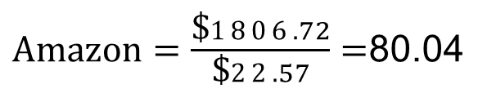
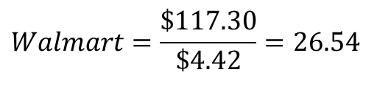
Example Growth Prospects and the Price-Earnings Ratio
Execute:
Forward P/E for
$\text{Amazon}=\frac{\text{\$}1806.72}{\text{\$}22.57}=$80.04
$$Walmart=\frac{\text{\$}\text{117.30}}{\text{\$}4.42}=26.54$$
Forward P/E for
Amazon’s P/E ratio is higher because investors expect its earnings to grow more than Walmart.
Next Year | 4.30%
Next Year | 31.80%
Next 5 Years (per annum) | 4.56%
Next 5 Years (per annum) | 50.30%

Slide 31
Example Growth Prospects and the Price-Earnings Ratio
Although both companies are retailers, they have very different growth prospects, as reflected in their P/E ratios.
Investors in Amazon.com are willing to pay 80.4 times this year’s expected earnings because they are also buying the present value of high future earnings created by expected growth.

Slide 32
The Price-Cash Flow Ratio
Companies can manipulate earnings
Cash-flow is less prone to manipulation
Cash-flow is important for fundamental valuation and in credit analysis

Slide 33
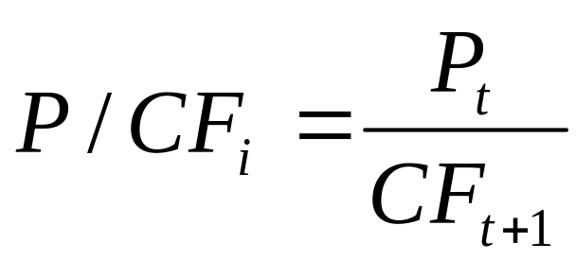
The Price-Cash Flow Ratio
Companies can manipulate earnings
Cash-flow is less prone to manipulation
Cash-flow is important for fundamental valuation and in credit analysis
Where:
P/CF_{j} = the price/cash flow ratio for firm j
P_{t} = the price of the stock in period t
CF_{t+1} = expected cash low per share for firm j
      Price to Free cash flow
      Because capital expenditures can vary between years, most common is to use enterprise value to EBITDA multiples

Slide 34
The Other Relative Values
Walmart Price/Sales | 0.64
Price/Book | 4.75
Enterprise Value/Revenue ³ | 0.79
Enterprise Value/EBITDA ⁶ | 12.53
Amazon Price/Sales | 3.37
Price/Book | 15.83
Enterprise Value/Revenue ³ | 3.46
Enterprise Value/EBITDA ⁶ | 26.89

Slide 35
The Price-Book Value Ratio
Widely used to measure bank values (most bank assets are liquid (bonds and commercial loans)
Fama and French study indicated inverse relationship between P/BV ratios and excess return for a cross section of stocks

Slide 36
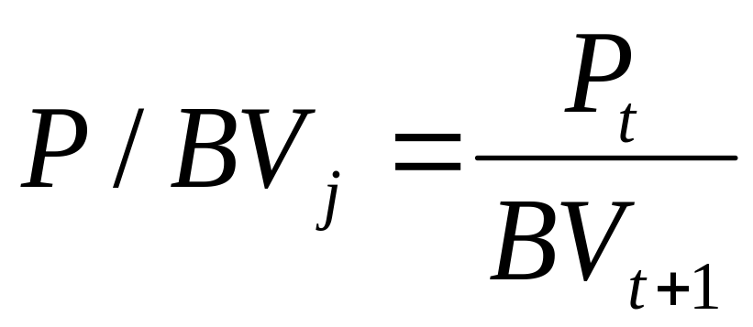
The Price-Book Value Ratio
Where:
P/BV_{j} = the price/book value for firm j
P_{t} = the end of year stock price for firm j
BV_{t+1} = the estimated end of year book value per share for firm j

Slide 37
The Price-Book Value Ratio
Be sure to match the price with either a recent book value number, or estimate the book value for the subsequent year
Can derive an estimate based upon historical growth rate for the series or use the growth rate implied by the sustainable growth rate g=(ROE) X (Retention Rate)

Slide 38
The Price-Sales Ratio
Match the stock price with recent annual sales, or future sales per share
This ratio varies dramatically by industry
Profit margins also vary by industry
Relative comparisons using P/S ratio should be between firms in similar industries

Slide 39
The Price-Sales Ratio
Strong, consistent growth rate is a requirement of a growth company
Sales is subject to less manipulation than other financial data

Slide 40
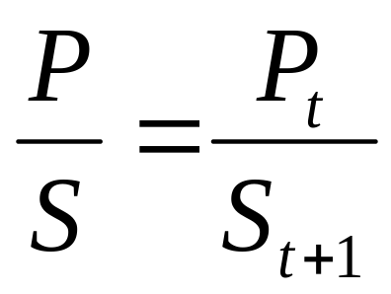
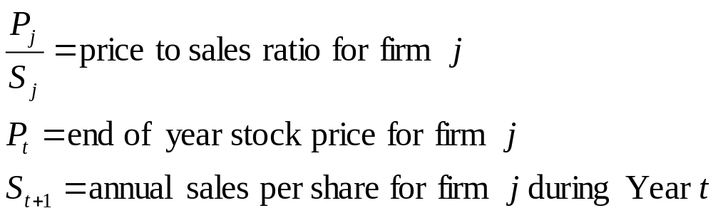
The Price-Sales Ratio
Where:

Slide 41
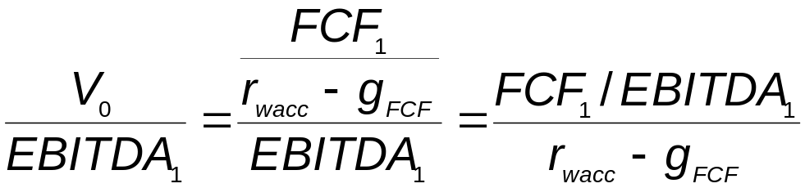
Valuation Based on Comparable Firms
When expected free cash flow growth is constant, we can write EV to EBITDA as:

Slide 42
Example Valuation Using the Enterprise Value Multiple
Problem:
Fairview, Inc., is an ocean transport company with EBITDA of $50 million, cash of $20 million, debt of $100 million, and 10 million shares outstanding.
The ocean transport industry as a whole has an average EV/EBITDA ratio of 8.5. What is one estimate of Fairview’s enterprise value?
What is a corresponding estimate of its stock price?

Slide 43
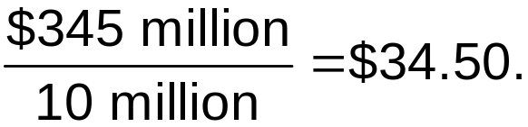
Valuation Using the Enterprise Value Multiple
Fairview’s enterprise value estimate is $50 million × 8.5 = $425 million.
Next, subtract the debt from its enterprise value and add in its cash: $425 million − $100 million + $20 million = $345 million, which is an estimate of the equity value.
Its stock price estimate is equal to its equity value estimate divided by the number of shares outstanding:

Slide 44
Valuation Using the Enterprise Value Multiple
Evaluate:
If we assume that Fairview should be valued similarly to the rest of the industry, then $425 million is a reasonable estimate of its enterprise value and $34.50 is a reasonable estimate of its stock price.
However, we are relying on the assumption that Fairview’s expected free cash flow growth is similar to the industry average. If that assumption is wrong, so is our valuation.

Slide 45
Valuation Based on Comparable Firms
Other multiples
  Multiples of sales can be useful if it is reasonable to assume margins are similar in the future
  Price-to-book value of equity can be used for firms with substantial tangible assets
  Some multiples are specific to an industry
    e.g. Cable TV – Enterprise value per subscriber

Slide 46
Valuation Based on Comparable Firms
Limitations of Multiples
  Firms are not identical
    Usefulness of a valuation multiple will depend on the nature of the differences and the sensitivity of the multiples to the differences
    Differences in multiples can be related to differences in
      Expected future growth rate
      Risk (cost of capital)
      Differences in accounting conventions between countries

Slide 47
Valuation Based on Comparable Firms
Limitations of Multiples
  Comparables provide only information regarding the value of the firm relative to other firms in the comparison set
    Cannot help determine whether an entire industry is overvalued
      Internet boom example

Slide 48
Valuation Based on Comparable Firms
Comparison with Discounted Cash Flow Methods
  Valuation multiple does not take into account material differences between firms
    Talented managers
    More efficient manufacturing processes
    Patents on new technology

Slide 49
Valuation Based on Comparable Firms
Comparison with Discounted Cash Flow Methods
  Discounted cash flow methods allow us to incorporate specific information about cost of capital or future growth
    Potential to be more accurate

Slide 50
Stock Valuation Techniques: A Final Word
No single technique provides a final answer regarding a stock’s true value
Practitioners use a combination of these approaches
Confidence comes from consistent results from a variety of these methods

Slide 51
Estimating the Inputs: The Required Rate of Return and The Expected Growth Rate of Valuation Variables
Valuation procedure is the same for securities around the world, but the required rate of return (R) and expected growth rate of earnings (g) and other valuation variables such as book value, cash flow, and dividends differ among countries

Slide 52
Required Rate of Return (R)
The investor’s required rate of return must be estimated regardless of the approach selected or technique applied
This will be used as the discount rate and also affects relative-valuation
This is not used for present value of free cash flow which uses the required rate of return on equity (R)
It is also not used in present value of operating cash flow which uses WACC

Slide 53
Required Rate of Return (R)
Three factors influence an investor’s required rate of return:
The economy’s real risk-free rate (RRFR)
The expected rate of inflation (I)
A risk premium (RP)

Slide 54
The Economy’s Real Risk-Free Rate
Minimum rate an investor should require
Depends on the real growth rate of the economy
  (Capital invested should grow as fast as the economy)
Rate is affected for short periods by tightness or ease of credit markets

Slide 55
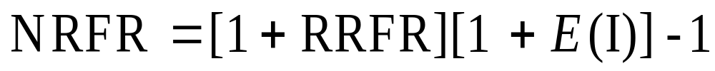
The Expected Rate of Inflation
Investors are interested in real rates of return that will allow them to increase their rate of consumption
The investor’s required nominal risk-free rate of return (NRFR) should be increased to reflect any expected inflation:
Where:
E(I) = expected rate of inflation

Slide 56
The Risk Premium
Causes differences in required rates of return on alternative investments
Explains the difference in expected returns among securities
Changes over time, both in yield spread and ratios of yields

Slide 57
Estimating the Required Return for Foreign Securities
Foreign Real RFR
  Should be determined by the real growth rate within the particular economy
  Can vary substantially among countries
Inflation Rate
  Estimate the expected rate of inflation, and adjust the NRFR for this expectation
NRFR=(1+Real Growth)x(1+Expected Inflation)-1

Slide 58
Risk Premium
Must be derived for each investment in each country
The five risk components vary between countries

Slide 59
Risk Components
Business risk
Financial risk
Liquidity risk
Exchange rate risk
Country risk

Slide 60
Expected Growth Rate of Dividends
Determined by
  the growth of earnings
  the proportion of earnings paid in dividends
In the short run, dividends can grow at a different rate than earnings due to changes in the payout ratio
Earnings growth is also affected by compounding of earnings retention
g = (Retention Rate) x (Return on Equity)
= RR x ROE

Slide 61
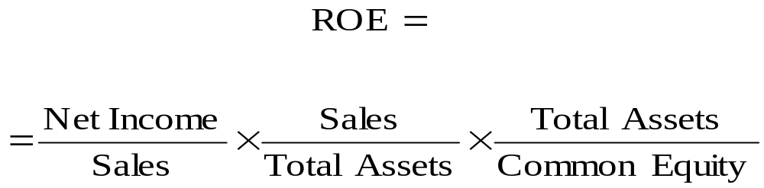
Breakdown of ROE
Profit Total Asset Financial
Margin Turnover Leverage
=
x
x

Slide 62
Estimating Growth Based on History
Historical growth rates of sales, earnings, cash flow, and dividends
Three techniques
  1. arithmetic or geometric average of annual percentage changes
  2. linear regression models
  3. long-linear regression models
All three use time-series plot of data

Slide 63
Estimating Dividend Growth for Foreign Stocks
Differences in accounting practices affect the components of ROE
Retention Rate
Net Profit Margin
Total Asset Turnover
Total Asset/Equity Ratio

Slide 64
An Alternate Measure of Growth
g = (RR)(ROIC)
where:
  RR = the average retention rate
  ROIC = EBIT (1-Tax Rate)/Total Capital

